Slide 1
CU-423 RoboLink
DC Motors
Dr. Mahmoud Sayed & Mahmoud Yassin
07-May-2026

Slide 2
What are we doing today?
Electricity, magnetism, and motion … what?
DC Motors.
Controlling DC motors speed & direction.
Powering DC motors: the motor driver.
How to steer your robot!

Slide 3
Electricity, Magnetism, and Force (Motion)
These 3 quantities affect each other in nature
The existence of two of them generates the third.
  Magnetism + Motion -> Electricity
  Magnetism + Electricity -> Force (Motion)
  Electricity (moving charges) -> Magnetism
E
F
M

Slide 4
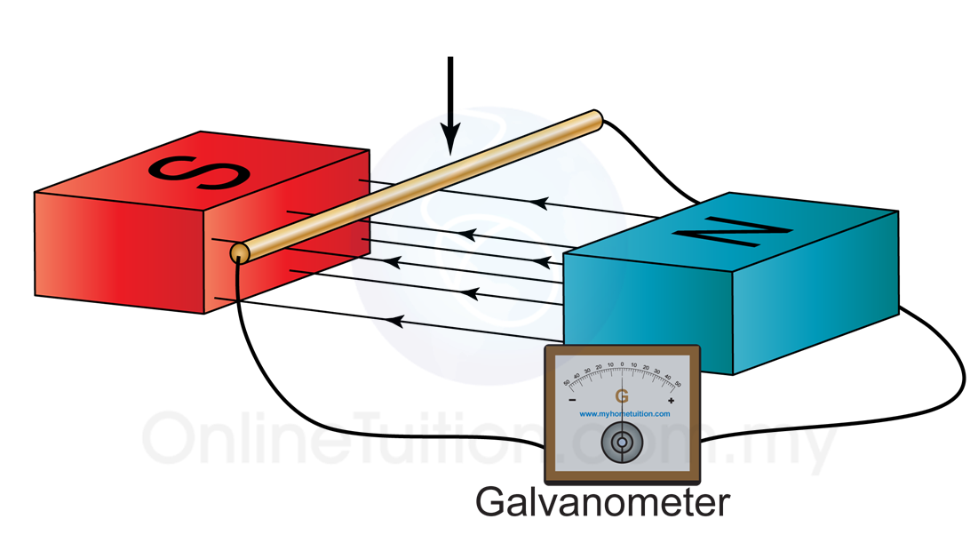
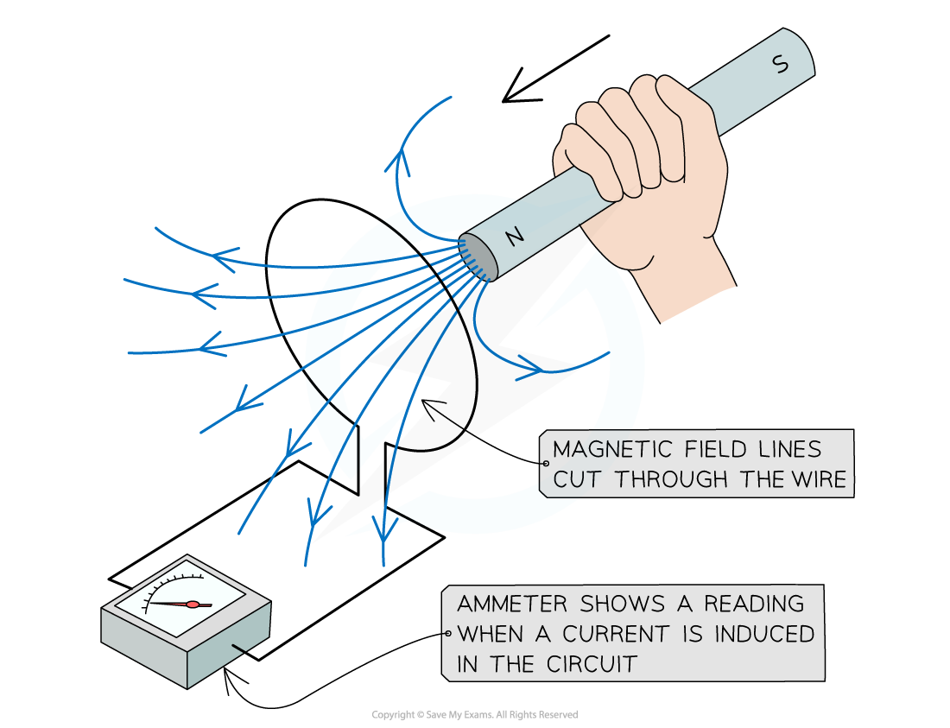
Magnetism + (Motion) -> Electricity
Moving a conductor perpendicular to magnetic field generates electricity (electromotive force)
  Generators!
  What else?

Slide 5
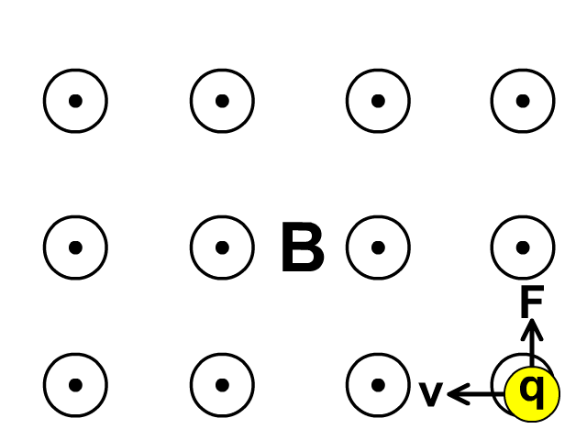
Electricity + Magnetism -> Force (Motion)
A charge moving through magnetic field experiences a force perpendicular to both of them

Slide 6
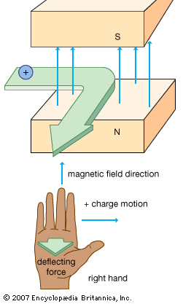
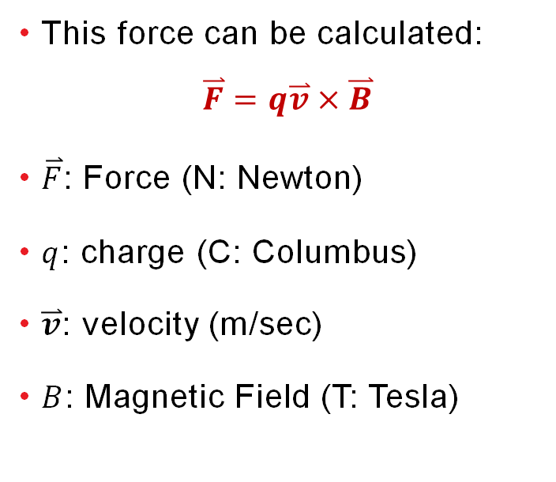
Electricity + Magnetism -> Force (Motion)
This force can be calculated:
$$\overset{⃑}{F}=q\overset{⃑}{v}×\overset{⃑}{B}$$
$\overset{⃑}{F}$: Force (N: Newton)
$q$: charge (C: Columbus)
$\overset{⃑}{v}$: velocity (m/sec)
$B$: Magnetic Field (T: Tesla)

Slide 7
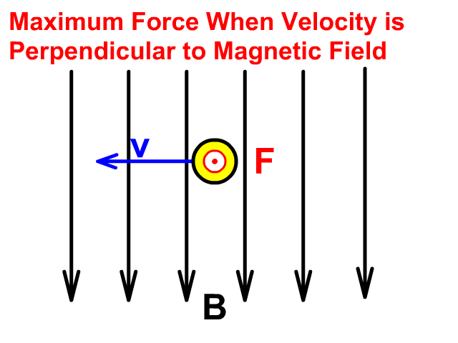
Electricity + Magnetism -> Force (Motion)
The current direction should be perpendicular to the magnetic field. Otherwise, no force will be induced

Slide 8
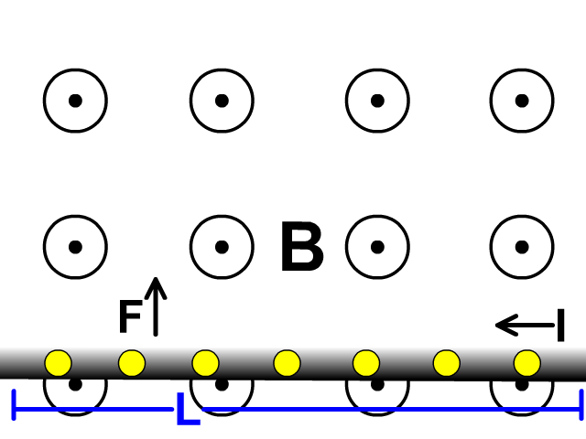
Electricity + Magnetism -> Force (Motion)
Similarly, a current carrying conductor experience a force in magnetic fields
What could be an application of that?
  Motors!
  What else?

Slide 9
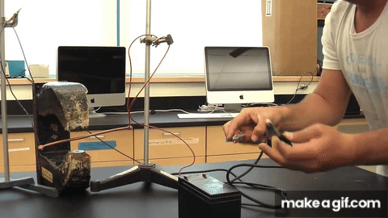
Electricity + Magnetism -> Force (Motion)
In action!

Slide 10
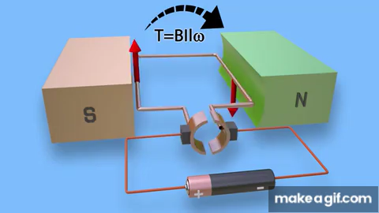
DC Motors
How DC motors work
  Left branch goes up
  Right branch go down
  Then we are stuck?!

Slide 11
DC Motors
How DC motors work
  Left branch goes up
  Right branch go down
  Then we are stuck?!
    No! The Brush mechanism reverses the current direction, so it continues.

Slide 12
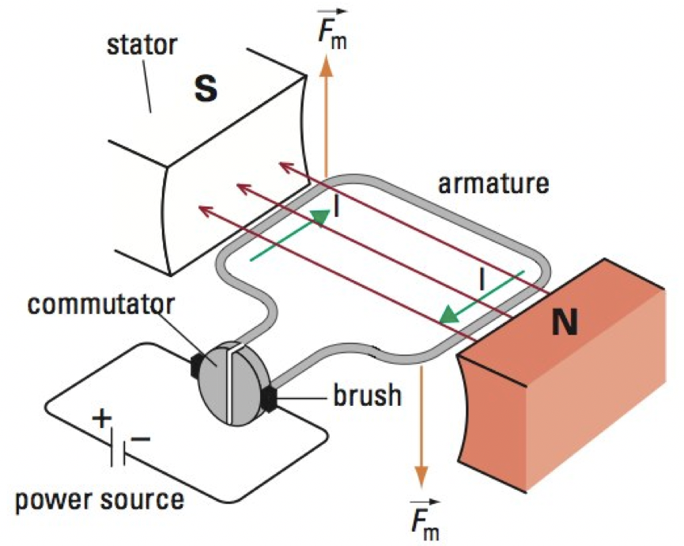
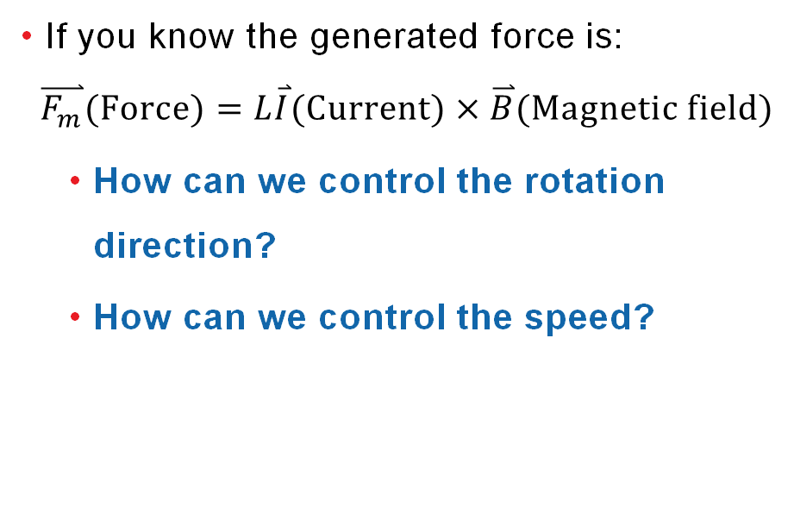
DC Motors
If you know the generated force is:
$$\overset{⃑}{F_{m}}(Force)=L\overset{⃑}{I}(Current)×\overset{⃑}{B}(Magnetic field)$$
  How can we control the rotation direction?
  How can we control the speed?

Slide 13
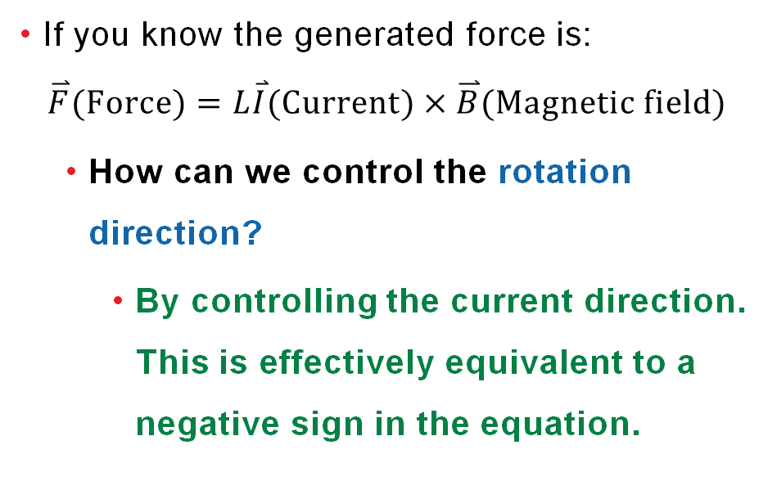
DC Motors – Direction Control
If you know the generated force is:
$$\overset{⃑}{F}(Force)=L\overset{⃑}{I}(Current)×\overset{⃑}{B}(Magnetic field)$$
  How can we control the rotation direction?
    By controlling the current direction. This is effectively equivalent to a negative sign in the equation.

Slide 14
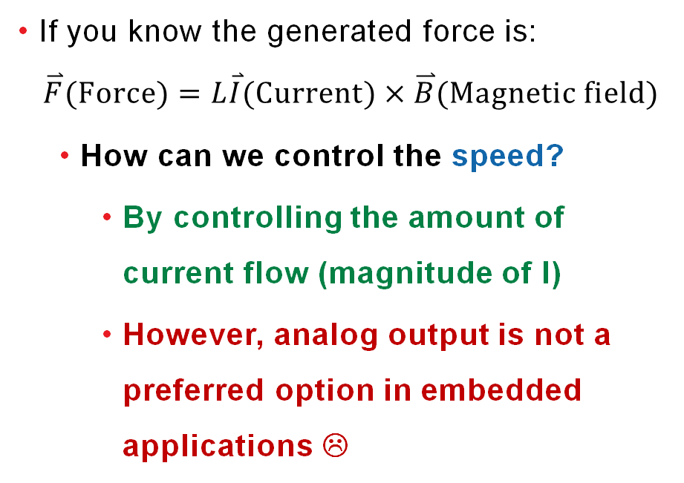
DC Motors – Speed Control
If you know the generated force is:
$$\overset{⃑}{F}(Force)=L\overset{⃑}{I}(Current)×\overset{⃑}{B}(Magnetic field)$$
  How can we control the speed?
    By controlling the amount of current flow (magnitude of I)
    However, analog output is not a preferred option in embedded applications ☹

Slide 15
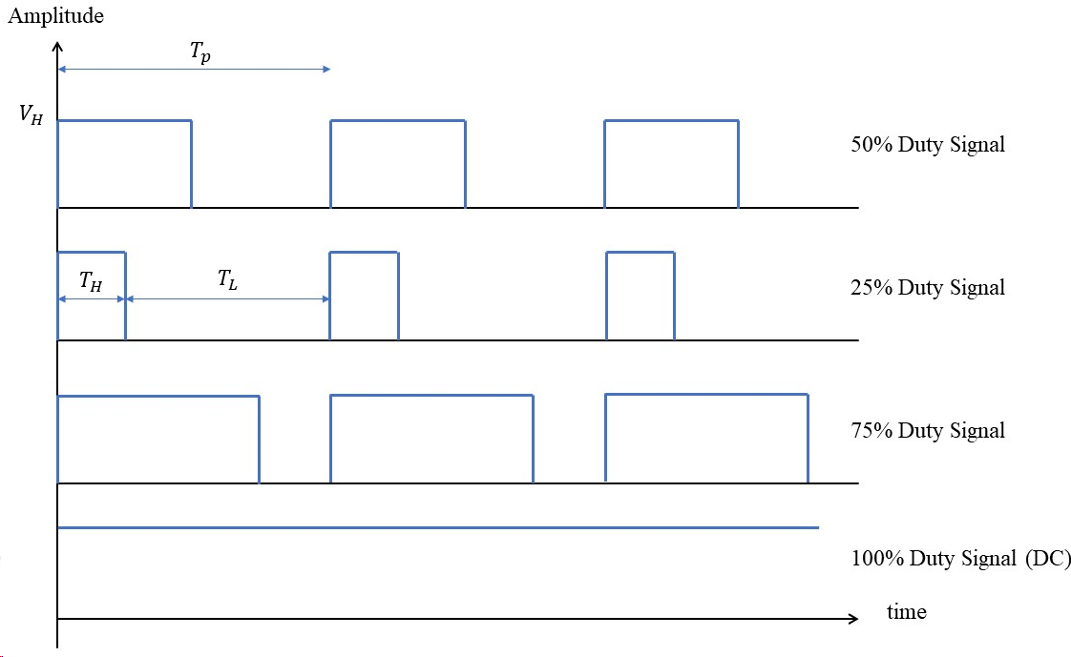
DC Motors – Speed Control
We can use Pulse Width Modulated Signals (PWM) !
Quick On/Off pulses, so quick that the motor’s mechanical inertia prevents vibrations (on/off effect)

Slide 16
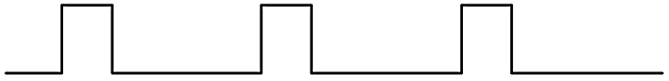
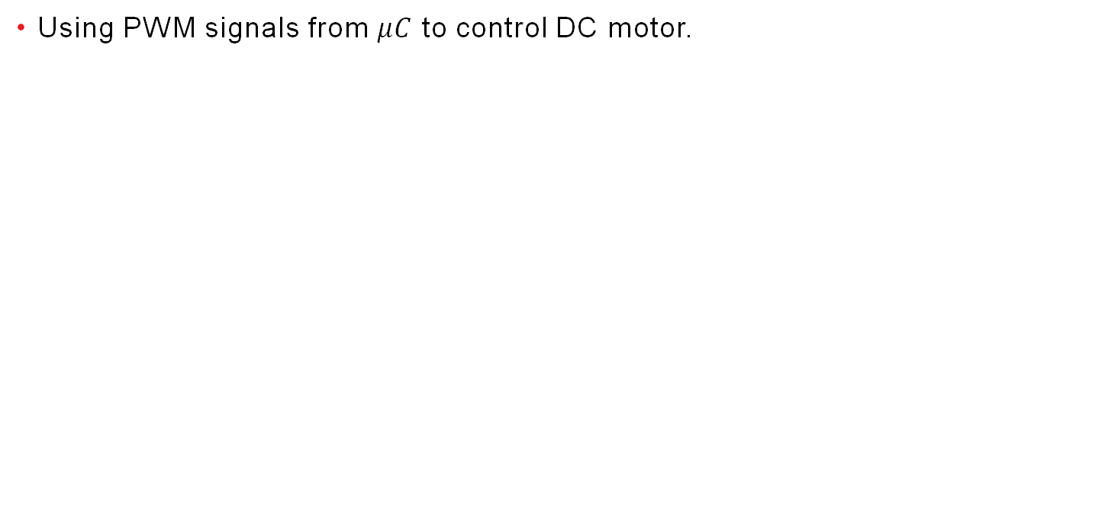
DC Motors - Control
Using PWM signals from $μC$ to control DC motor.
Microcontroller
Microcontroller
Pin 1 Output
(PWM)
Pin 1 Output
(0)
M
M
Pin 2 Output
(0V)
Pin 2 Output
(PWM)
Motors need higher power and voltage!

Slide 17

DC Motor - Control
Using PWM signals from $μC$ to control DC motor.
  Microcontrollers are used to “control”, not to provide power.
  Interfacing circuits need to be used to control heavy loads.
Microcontroller
Interfacing Circuit
Control signal
POWER signal
M
Control signal

Slide 18









DC Motor – Motor Driver Circuit
Using PWM signals from $μC$ to control DC motor.
  One popular interface circuit to control DC motors is the H-Bridge.
$$V_{cc}$$
0
0
$$T_{1}$$
$$T_{3}$$
X
$${In}_{1}$$
0
0
$${In}_{2}$$
$$T_{2}$$
$$T_{4}$$
X
0
$$En$$
Gnd

Slide 19
DC Motor – Motor Driver Circuit
Using PWM signals from $μC$ to control DC motor.
  One popular interface circuit to control DC motors is the H-Bridge.
$$V_{cc}$$
1
0
$$T_{1}$$
$$T_{3}$$
1
$${In}_{1}$$
0
1
$${In}_{2}$$
$$T_{2}$$
$$T_{4}$$
0
1
$$En$$
Gnd

Slide 20
DC Motor – Motor Driver Circuit
Using PWM signals from $μC$ to control DC motor.
  One popular interface circuit to control DC motors is the H-Bridge.
$$V_{cc}$$
0
1
$$T_{1}$$
$$T_{3}$$
0
$${In}_{1}$$
1
0
$${In}_{2}$$
$$T_{2}$$
$$T_{4}$$
1
1
$$En$$
Gnd

Slide 21
DC Motor – Motor Driver Circuit
Using PWM signals from $μC$ to control DC motor.
  One popular interface circuit to control DC motors is the H-Bridge.
$$V_{cc}$$
1
1
$$T_{1}$$
$$T_{3}$$
1
$${In}_{1}$$
0
0
$${In}_{2}$$
$$T_{2}$$
$$T_{4}$$
1
1
$$En$$
Gnd

Slide 22
DC Motor – Motor Driver Circuit
Using PWM signals from $μC$ to control DC motor.
  One popular interface circuit to control DC motors is the H-Bridge.
$$V_{cc}$$
0
0
$$T_{1}$$
$$T_{3}$$
0
$${In}_{1}$$
1
1
$${In}_{2}$$
$$T_{2}$$
$$T_{4}$$
0
1
$$En$$
Gnd

Slide 23





DC Motor – Motor Driver Circuit
Using PWM signals from $μC$ to control DC motor.
  One popular interface circuit to control DC motors is the H-Bridge.
$$V_{cc}$$
0
1
$$T_{1}$$
$$T_{3}$$
Microcontroller
Direction
0
1
0
$$T_{2}$$
$$T_{4}$$
PWM
1
Gnd

Slide 24
DC Motor – Motor Driver Circuit
Using PWM signals from $μC$ to control DC motor.
  One popular interface circuit to control DC motors is the H-Bridge.
$$V_{cc}$$
Remove some inverters!
0
1
$$T_{1}$$
$$T_{3}$$
Microcontroller
Direction
0
1
0
$$T_{2}$$
$$T_{4}$$
PWM
1
Gnd

Slide 25
Robot Steering?
Assume you have a robot like this one, you have full control over the motors attached to the wheels.
  How can you steer the robot (e.g., turn right or left)?

Slide 26
Robot Steering?
By controlling the speed of the wheels relative to each other!

Slide 27
Break!

Slide 28
Functions!
A block of code that runs only when called.
Functions are important for code reusing: Some code that will be used multiple times in different places.
  Define once, use any number of times.
Function: takes parameters (Optional)
Do some task
Return a value (Optional)
C++ Functions
C++ Function Parameters

Slide 29
Functions!
Define a function that takes the radius of a circle and returns its area.
  Give it the name CircleArea
In the loop function, allow the user to input the radius.
Store the value, then hand it out to CircleArea.
Then print the return to the user.

Slide 30
Questions?

